Slide 1


KidneyCare:365
An Introduction to Kidney Disease
Notes:
NOTES ABOUT THIS PRESENTATION
So that you can guide the pace of your class, all slides must be clicked to advance. There is some animation within slides to keep your audience engaged. Some slides build on click so that you have time to make points as you go. Please familiarize yourself with click points.
Talking points are included in the notes section to help you guide the content of your class.
All content in the notes should be covered, but please feel free to personalize introductions and transitions so that the language feels natural to you.
Videos are included in the presentation to help bring the content to life. Please click to play.
At the end of each section, there is a Q&A slide. First, open the class up to questions. If no one responds, click through to prepared questions and answers. You can cover all of the questions or some if you’re short on time.
There is an appendix section that contains in-depth information on ESRD treatment options and types of access. Please use these slides to help answer any questions or cover more details as appropriate.
The accompanying KidneyCare:365 handout may be distributed at the beginning of the class, as indicated in the intro section. Before your class, please insert your business card in the slits on the back page, so participants leave with your contact information.
Before class starts, provide a sign-up sheet to capture email addresses so participants can receive more CKD info, tips for managing health and kidney-friendly recipes.

Slide 2





The 5 stages of kidney disease
STAGE 1
eGFR 120-90
Evidence of kidney disease with normal kidney function
STAGE 2
eGFR 89-60
Mild to moderate
loss of kidney function
STAGE 3
eGFR 59-30
Moderate to severe
loss of kidney function
STAGE 4
eGFR 29-16
Severe loss of
kidney function
STAGE 5 – ESRD
eGFR 15 or less
Kidney failure and the need for dialysis or transplant
Notes:
Kidney disease is broken into 5 stages based on kidney function. In the earliest stage, kidney function is normal. By stage 5, the kidneys have stopped functioning, and dialysis treatment or a transplant is needed to prolong life.
Stages 1–4 are considered chronic kidney disease or CKD for short. Stage 5 is kidney failure or end stage renal disease, often abbreviated as ESRD.

Slide 3
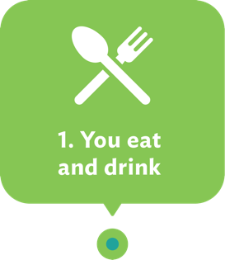
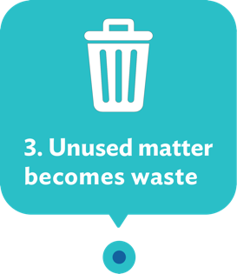
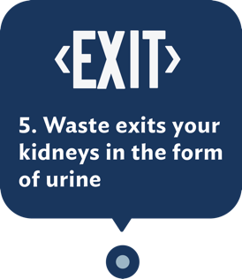
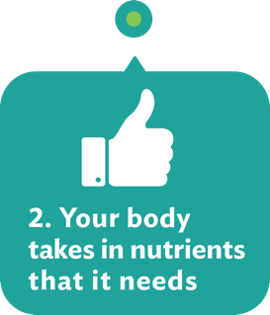
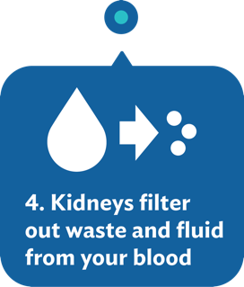
Healthy kidneys filter waste, toxins and excess fluid from your blood
Notes:
Your kidneys play a big role in your body’s health. Your kidneys filter waste, toxins and excess fluid from your blood to keep your blood chemically balanced and keep a healthy amount of fluid in your body.

Slide 4
With kidney disease, lack of filtration causes a buildup of waste, toxins and fluid
WASTE
TOXINS
EXCESS FLUID
TOXINS
WASTE
EXCESS FLUID
Notes:
However, when your kidneys aren’t working as well as they should, waste, toxins and fluid can build up and impact your health.

Slide 5






Signs or symptoms you may notice in later stages
Changes in urination
Fatigue or nausea
Itching
Swelling in hands and feet
Shortness of breath
Pain in your lower back
Notes:
You may or may not notice some of these symptoms in later stages:
Changes in urination
Fatigue or nausea
Itching
Swelling in hands and feet
Shortness of breath
Pain in your lower back

Slide 6


Good news
There are steps you can take at every stage.
Managing your health can help slow the progression of CKD.
Knowledge is power.
Notes:
The good news is: there are things you can do at every stage of CKD to help manage your kidney health, slow the progression of CKD and thrive. Knowledge is power—and today’s class will help you learn what to do and what to expect.
This class is informal, so we’ll address questions as we go—any question is a good question, so please ask. Someone else in the room is probably wondering too. Is there anything that anyone is particularly interested in right off the bat? [If so, set expectations for when it will be addressed and who will cover the information.]
Okay, let’s talk about the basics of kidney health.

Slide 7
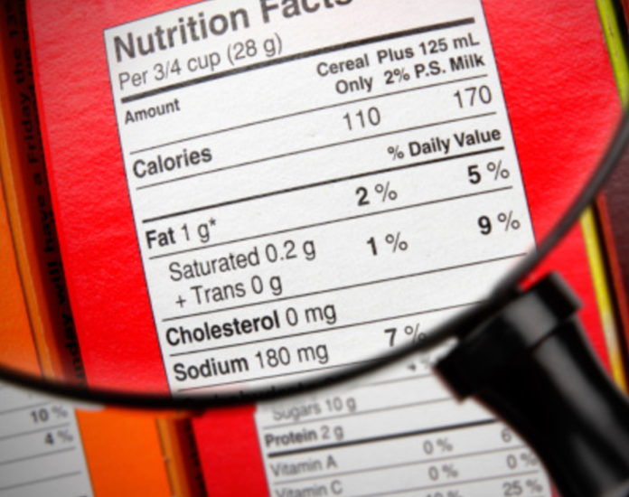
What’s so bad about salt?
Sodium causes fluid retention, which can lead to:
  Swelling
  Shortness of breath
Too much fluid can cause heart failure, high blood pressure and increased risk for stroke.
Salt is easily hidden in processed or prepackaged foods.
Notes:
“What’s so bad about salt?” Consuming a lot of salt or sodium can cause fluid retention and throw off the balance in your body that your kidneys are fighting to maintain.
Fluid retention can cause swelling and shortness of breath.
Too much fluid can cause heart failure, high blood pressure and increased risk for stroke.
It’s important to avoid both adding salt to your food and consuming foods that already contain salt or sodium. Salt is easily hidden in processed or prepackaged foods, as well as seasoning blends, so it’s really important to read food labels and be aware.

Slide 8

What is phosphorus exactly—and how do I avoid it?
Phosphorus is a mineral that works with calcium in your body.
If uncontrolled, buildup can be harmful.
It’s found in dairy, chocolate and many processed foods.
Eating fresh foods can help you avoid phosphorus.
Notes:
What is phosphorus exactly—and how do I avoid it? Phosphorus is a mineral that’s found in many foods and that works with calcium to build strong bones and keep your body healthy.
When your kidneys can no longer keep your phosphorus at the right level, it builds up and becomes harmful to your body. An excess of phosphorus can cause an increased risk of hip fractures and cardiovascular disease.
Foods that are high in phosphorus include: dairy, chocolate and processed foods like biscuits, hot dogs, pizza and snack cakes. Eating fresh foods and checking food labels can help you avoid phosphorus.

Slide 9

Eating well at stage 5 while on dialysis
New guidelines to follow:
Increase your protein consumption.
Continue to avoid salt, sodium and phosphorus.
Limit your fluid intake.
Work closely with your
renal dietitian.
Notes:
At stage 5, if you go on dialysis, some of the eating guidelines change. Dialysis changes the way your body processes food, so some of the guidelines are the same as in stages 1–4 of CKD and some change.
One big change is that more protein is typically needed once you go on dialysis. You’ll still need to avoid salt, sodium and phosphorus.
Because dialysis works to remove excess fluid from your body, you’ll also need to limit the amount of fluid you consume.
If this seems like a lot to remember, don’t worry! As part of your dialysis care team, you’ll have a dietitian who will be there to help.

Slide 10




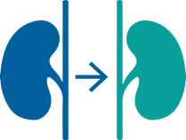

ESRD treatment options to consider
Dialysis
At-home peritoneal dialysis
At-home hemodialysis
In-center hemodialysis
Transplant
Supportive Care
Notes:
At stage 5, or end stage renal disease, you may choose to go on dialysis, plan for a transplant or opt for supportive care.
Dialysis can be performed in the comfort of your own home or in a center. Options include:
At-home peritoneal dialysis, also known as PD—which filters your blood naturally using many tiny blood vessels in the lining of your abdomen and can be performed by yourself in the comfort of your home—even while you sleep.
Hemodialysis—which filters your blood through a dialyzer and can be done either
At home, with or without a care partner, depending on your therapy choice,
or,
In center, so you can be around other people on dialysis.
Kidney transplant—is considered the closest to natural kidney function when successful, though not everyone is a candidate and this option takes time.
Supportive care—which means being treated to manage discomfort as nature takes its course instead of treating to prolong life.

Slide 11

In-center hemodialysis
Done in a dialysis center, with your care team
Typical schedule:
  3 times a week, 3-5 hours per session
  3 nights a week, 8 hours per session for
  nocturnal (nighttime) option
Benefits:
Treatment performed and/or monitored by trained nurses and technicians
Labs and checkups done in one place
Opportunity for social connection with others
Notes:
In-center hemodialysis is very similar to at-home hemodialysis, only your treatment is performed and/or monitored by a team of trained nurses and technicians in a dialysis center.
You are connected to an artificial kidney (dialyzer) via your access site and then your blood is filtered through the dialyzer and returned to your body.
A typical treatment schedule is 3 times a week for 3 to 5 hours per session but your nephrologist will prescribe the exact amount of dialysis you need. Some centers also offer nighttime or nocturnal dialysis, which is usually 3 nights a week for about 8 hours per session.
In-center hemodialysis might be right for you if you prefer your treatment to be performed and/or monitored by a professional care team, or if you like having all of your labs, checkups and appointments done in the same location. You might also choose this option if you want to connect socially with other people who are on dialysis.
Something else to consider with in-center treatment is the commitment needed to stay on schedule with treatment. With this option, you’ll need to plan for travel time to and from the center in addition to your actual treatment time.

Slide 12
Access types for hemodialysis:
fistula (AV or AVF)
Utilizes existing blood vessels
Most natural
Best choice for hemodialysis
Optimal blood flow and low chance of infection
6-8 weeks to mature
All access surgeries are minor outpatient procedures.
Notes:
If you choose at-home or in-center hemodialysis, it’s important to learn all you can about the various access types and discuss them with your doctor.
There are 3 types of access used for hemodialysis—fistula, graft and hemodialysis catheter.
A fistula is the preferred choice of access.
A fistula is formed by the joining of a vein and an artery in your arm. Because a fistula uses existing blood vessels, it’s considered the most natural option.
A fistula is also considered the very best choice for hemodialysis because it allows for optimal blood flow during treatment and has the lowest chance of infection.
Getting a fistula is a minor outpatient procedure, though it takes about 6 to 8 weeks to mature before you can use it. Therefore, planning ahead is really important, so you can start treatment with your preferred access.

Slide 13
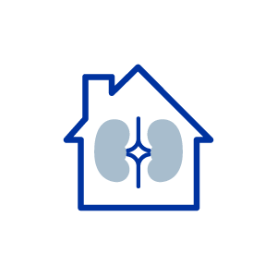






Understanding benefits of home dialysis
  Dialysis on
  your schedule
  Fewer food restrictions
  Fewer medications
  Award-winning training
  24/7 support
  Freedom to travel and work
Notes:
Freedom to control your schedule—travel and work where and when you want. You have more freedom with your diet. You may also have fewer medications.
And most importantly, one of the key benefits with our home dialysis treatments is that you are never alone. You will have access to our award-winning training and on-call 24/7 support. Home dialysis is absolutely something you can do, and we’ll be right there with you—just a call away.

Slide 14
At-home peritoneal dialysis (PD)
Done in your home, by yourself, or with a care partner’s help, if you prefer
Typical treatment schedule:
  3-5 times daily, 20-30 minutes per session
  Overnight, 8-10 hours every night
Benefits:
No needles, generally painless
May help preserve residual kidney function
Can be done almost anywhere—home, work, traveling
Frequent treatments mean feeling better
Fewer restrictions to your diet & fluid intake
Notes:
Now let’s talk about each of the dialysis options in a little more detail.
At-home peritoneal dialysis—or PD—is done in the comfort of your home and you can administer this treatment by yourself. Your blood is filtered naturally using many tiny blood vessels in the lining of your abdomen, which is also called the peritoneum.
With PD, your blood never leaves your body, no needles are involved and it is generally painless.
Typical session times vary based on whether you choose:
continuous ambulatory PD, or CAPD, which is 20–30 min sessions 3–5 times a day
OR
automated PD, or APD, which is done using a machine while you’re sleeping for about 8 hours every night.
PD may also help preserve residual kidney function.
PD could be right for you if you want the most flexibility in when and where you treat. Daytime PD can be done almost anywhere—at home, at work or while traveling.
Because PD is done daily, toxins don’t have a chance to build up, so people often feel better and can be more active with this course of treatment. Less buildup means that people who do PD often have fewer restrictions on diet and fluid intake.
Also it’s important to note that even though you’re performing your own dialysis with PD, you can always access 24/7 nursing assistance if you need it. Plus, you can track your data, lab results and goals online through your Portal.

Slide 15
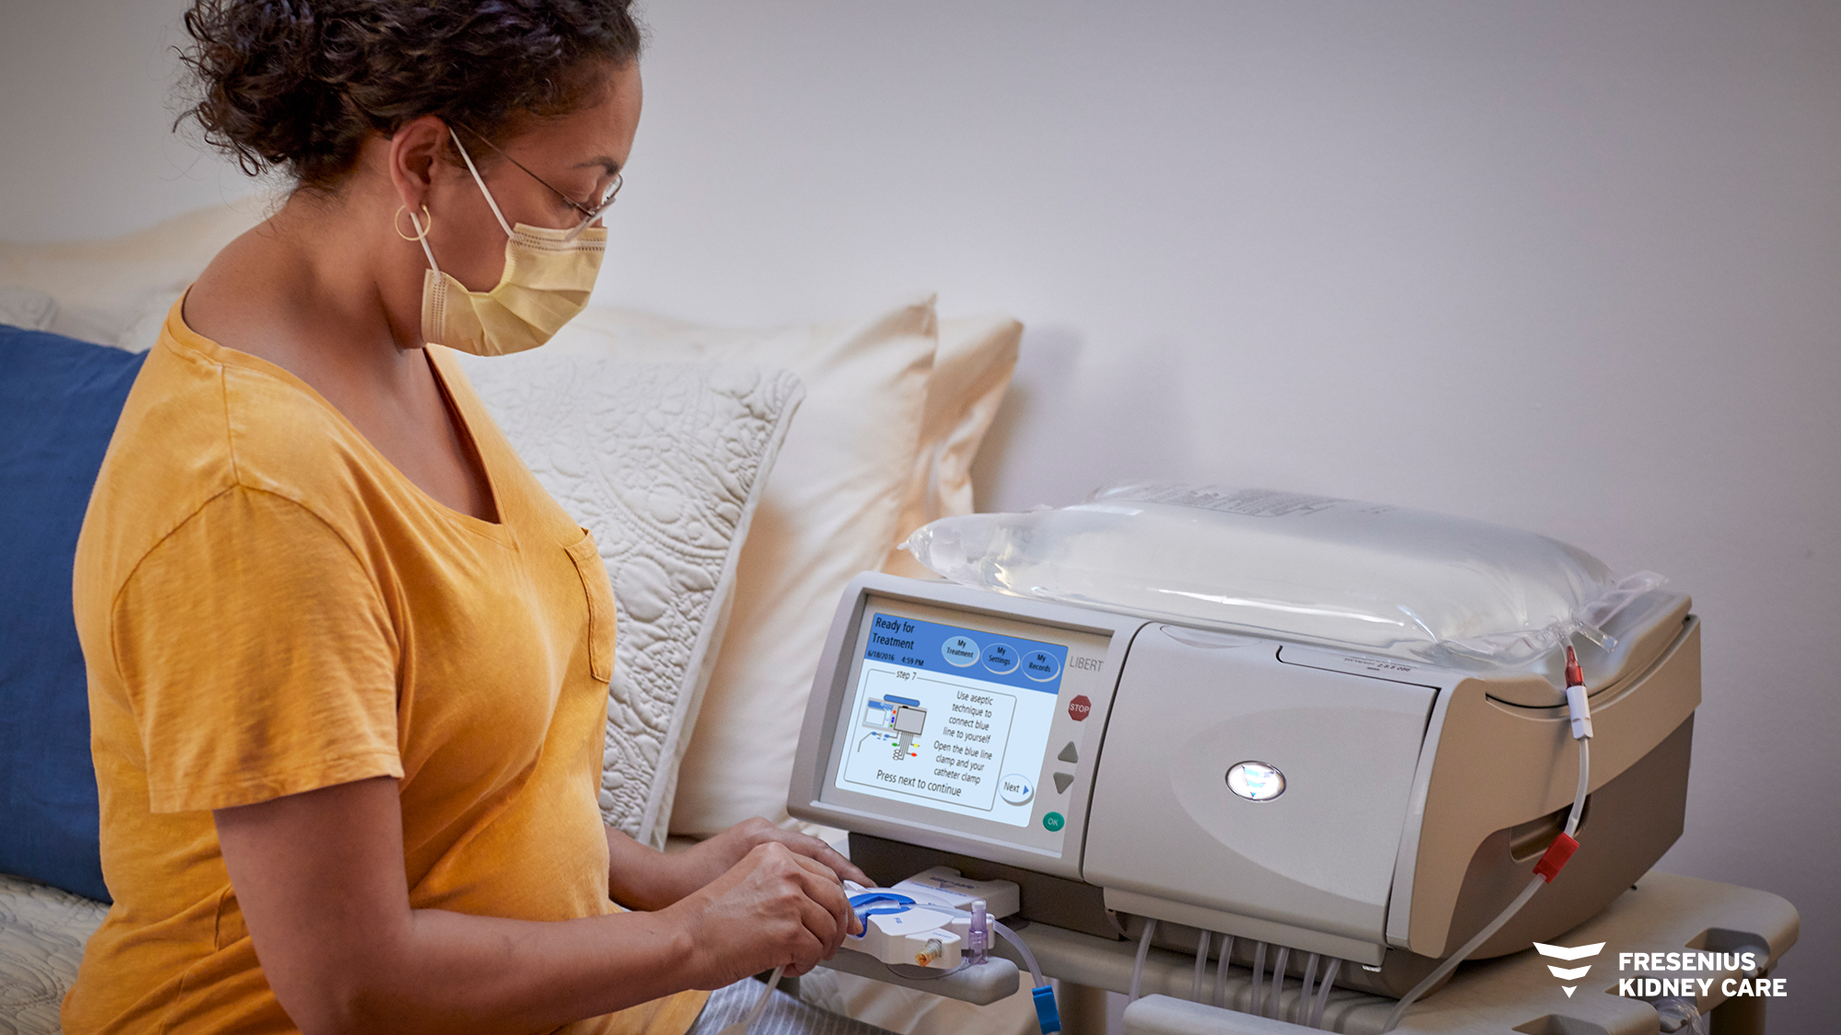
Peritoneal Dialysis Cycler

Slide 16

Access type for at-home PD: peritoneal catheter
Only type of access for PD
Flexible tubing in abdomen
No needles required
Self-care required for cleaning
Minor outpatient surgery
A few days to 2 weeks healing
time
All access surgeries are minor outpatient procedures.
Notes:
If you choose at-home peritoneal dialysis, you’ll use an abdominal or peritoneal catheter to give access to your peritoneum. This is the only type of access for this particular treatment option.
The PD catheter is a flexible hollow tube that’s placed in the abdomen with a small piece of tubing left outside of the body to connect to the dialysis equipment. Because it’s so small and flexible, that part of the PD catheter is easily concealed by clothing.
What makes a PD catheter unique is that it’s not inserted into your blood vessels—or the vascular system—so it doesn’t carry the same risks of infection that a hemodialysis catheter does. They’re 2 completely different types of access.
However, because the PD catheter is a point of entry into the the abdominal cavity, precautions have to be taken with each treatment to avoid infection. So this access type does require self-care and you must have a clean and sanitized treatment space at home—or wherever you’re doing your treatments—in order to avoid infection.
Getting a PD catheter is a minor outpatient procedure. Healing time varies but generally it’s a few days to 2 weeks before the catheter is healed well enough for full-time use.

Slide 17
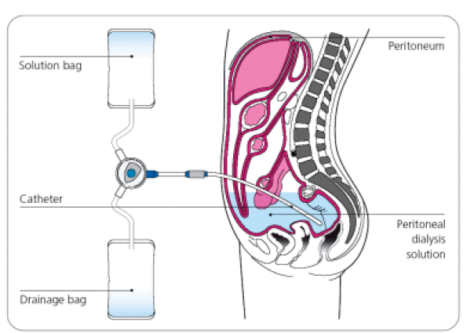

PD Process
CAPD
3 to 5 exchanges
Gravity
Simple
Notes:
- Usually 4 daytime manual exchanges 4-6 hours apart
-30-45 minutes per exchange
-gravity fill and drain
-most ages and mental status can learn
-Usually at night
- Has a 9 hour average treatment time

Slide 18
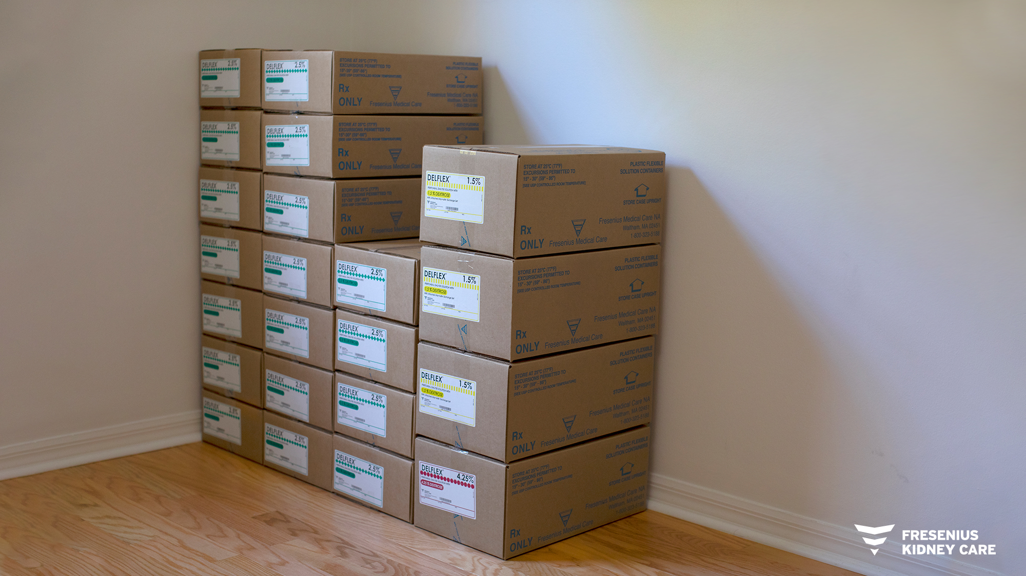
Peritoneal Supplies

Slide 19

Flexibility and Freedom on the Open Road with Peritoneal Dialysis: Glenda and Sherman's Story

Slide 20


At-home hemodialysis (HD)
Done in your home, with or without a care partner, depending on your therapy choice
Typical treatment schedule:
  3 times a week, 3-5+ hours per session
  5-6 times a week, 2.5-3 hours per session
  Overnight, 6-8 hours per session
Benefits:
Plan your treatment around your schedule
Save on travel time and transportation costs
Feel better and have more energy
Possibly get more freedom with your diet
Notes:
At-home hemodialysis is another at-home option, but a completely different method of dialysis.
At-home hemodialysis is done at home with or without the assistance of a care partner, depending on your therapy choice. If you use a care partner, whoever your care partner is--a spouse, a close friend, etc.--that person will be fully trained to help you with treatment.
During treatment, you are connected via your access to a dialyzer machine, also called an “artificial kidney.” The at-home version of this machine is similar to the machine used at the center and designed for at-home use. Your blood is filtered through the dialyzer and returned to your body.
Depending on what your nephrologist prescribes, frequency and duration of treatment can vary, but the typical schedule is:
3 days per week, with sessions of 3 to 5 hours at a time, or,
5-6 days per week, with sessions of 2.5 to 3 hours at a time, or,
If you want to treat overnight, it’s usually 6 to 8 hours every night.
One of the big benefits of at-home hemodialysis is that it allows you the flexibility to fit treatment in around work, school, social activities or hobbies in the way that works best for you and your lifestyle.
You save on travel time and transportation costs to and from the center. As with PD, you may feel better and be more energetic because you’re able to treat more frequently and longer than you would in the center. You may even have a bit more freedom with your diet.
If you ever need help or have questions, a nurse is standing by 24/7. And you can go online to track your data, lab results and goals using your Portal.
If you're deciding between at-home hemo and PD, there are several factors to think about and discuss with your doctor, including:
The type of access you're most comfortable with
Whether or not you need a care partner to perform treatment with you (some types of at-home dialysis require a care partner, others do not)
If you prefer to treat at home or you need more flexibility on treatment location

Slide 21
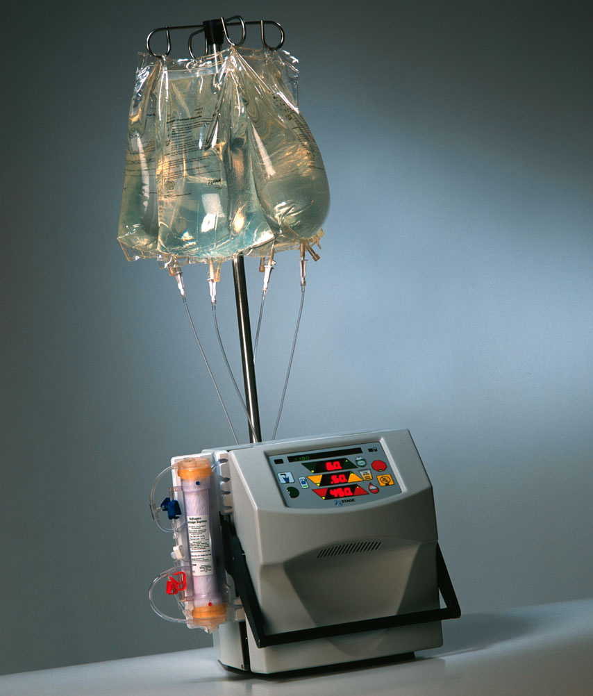
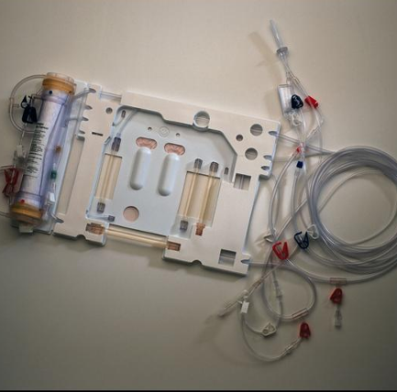
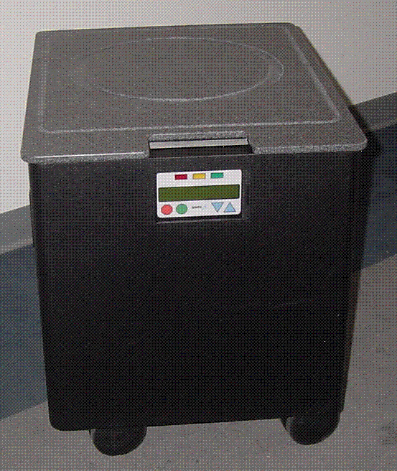
NxStage System
Cycler
Disposable Cartridge
Pureflow Water System
Prepackaged Dialysate bags
Notes:
Benefits: Travel Possible, although only about 10% will travel. Can be done with no running water.

Slide 22

Gaining Independence Through Home Hemodialysis: Kenneth’s Story

Slide 23
Access types for hemodialysis:
catheter (if medically necessary)
Least desirable option
Tubing in neck, chest or groin
Temporary solution and not for
long-term use
Higher risks of infection and clotting
Minor outpatient surgery
Ready for immediate use
All access surgeries are minor outpatient procedures.
Notes:
The 3rd type of access for hemodialysis is a catheter, which should only be used if you aren’t able to get a fistula or a graft—or while you’re waiting for another type of access to heal.
A catheter tube is placed in your neck, chest or groin.
The reason it’s the least desirable hemodialysis access type is that it has higher risks of infection and clotting.
Hemodialysis catheters shouldn’t be used long term.
Getting a hemodialysis catheter is also minor outpatient surgery and then it’s ready for immediate use.
No matter which type of access site you choose, taking care of it is essential—you will have a nurse that will train you on cleaning and maintaining your access so you can stay your healthiest.

Slide 24

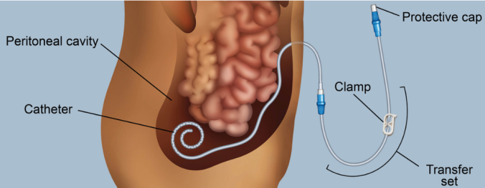
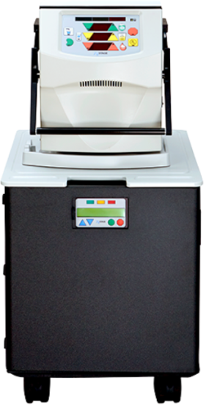

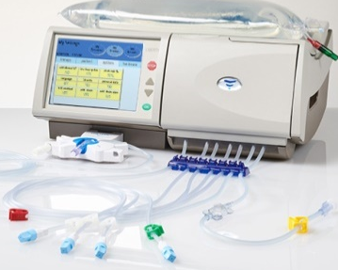
Dialysis Treatment Options:
At-home peritoneal dialysis
At-home hemodialysis
In-center hemodialysis
Done in a dialysis center, with care team
- Typical schedule
- 3 times per week
- 4 hours per session

Slide 25
Kidney transplant
Benefits:
Closest to natural kidney function
Highly effective for ESRD when successful
Considerations:
Your overall health
Availability of a good kidney donor match
Timing for procedure
Strict guidelines for eligibility
Notes:
A transplant is a non-dialysis treatment option for end stage renal disease, though some dialysis may be necessary before surgery.
A successful kidney transplant—transplanting a healthy kidney into the body of a person living with CKD—is considered one of the most effective treatments for ESRD.
There are several factors to understand and discuss with your doctor if you’re considering a transplant. Having a successful surgery depends on several things:
Having good overall health aside from CKD
Your doctor will want to make sure that your health is in good condition to help support a good outcome.
A good kidney donor match
For a transplant to be successful, the new kidney must be from a donor who has the same tissue type and a compatible blood type. An ideal match is from a living donor, usually a relative—though there have been advances in donor matching.
Timing
Ideally, transplant surgery should be performed before you actually need dialysis. A lot of different factors have to come together at the right time for a transplant to be an option. Most people electing a transplant need to wait for a good donor match, which takes an average of 3–5 years. Dialysis treatment may be necessary in the meantime to maintain kidney function.
It’s also important to understand that because of the strict requirements for a successful procedure, not everyone will be a candidate for transplant. Only your doctor can determine if you qualify.

Slide 26
Supportive care
Sometimes, dialysis isn’t the right choice, due to:
Other critical health conditions
Quality-of-life considerations
Supportive care focuses on:
Maintaining quality of life
Relieving discomfort
Notes:
Supportive care is a choice some people consider when dialysis isn’t the right option for them—due to other critical health conditions, beliefs or quality-of-life considerations.
Supportive care is an alternative to dialysis treatment that lets nature take its course, rather than treating to prolong life.
The goal of supportive care is to help a person maintain as high a quality of life as possible, while managing comfort as ESRD progresses.
Choosing not to go on dialysis is, of course, a big decision to discuss with loved ones and your medical care team.

Slide 27
Q&A
Treatment options
Notes:
Does anyone have any questions about treatment options or types of access?

